Slide 1

Project:
Yelp Data Analysis
Neha Kumari
MSIT - Clark University

Slide 2

Business Presentation

Slide 3
1. Number of Users Joined Yelp Since 2010

Slide 4
2. List of Elite Users from 2012 through 2021

Slide 5

The number of elite users are increasing every year from 2012 to 2021, but for year 2020 there is no data present for elite users.

Slide 6

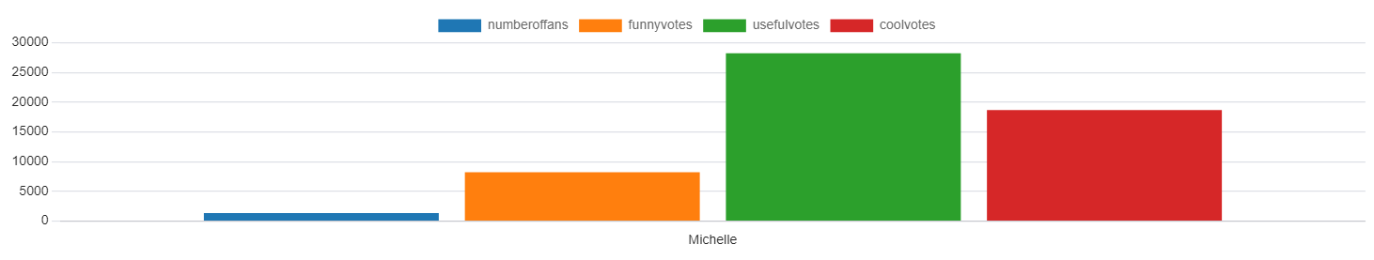
3. Details of User with the most 5-Star Reviews
Name : Michelle
Date and time when they joined yelp : 2008-03-28 , 13:26:38
Number of Fans : 1353
Number of Funny Ratings they have gotten : 8198
Number of Useful Ratings they have gotten : 28235
Number of Cool Ratings they have gotten : 18687

Slide 7
Example of some recent 5-star reviews given by Michelle
1. I met up with a friend for lunch outside on a gorgeous afternoon a few weeks ago. There were plenty of outdoor tables which were covered by a tent that was open along one side. Because it was so sunny, it actually felt quite warm but I bet the tent would be great at blocking some wind on a chillier day.
I was happy to see some booze free options on the beverage list, and ordered a Don't Call Me Shirley, which was a simple club soda with housemade grenadine - fantastic!
We shared the arugula salad, margherita and mushroom pizzas. I specifically requested the salad first but everything was brought out at the same time. Nonetheless, every single item was delicious! So delicious, that my husband and I ordered dinner from the Pizzeria Vetri in Rittenhouse that same night.
I feel like Philadelphia has gone from pizza desert to pizza wonderland in a pretty short time. I don't always think of Vetri when I think of pizza, but it's a consistently solid spot that shouldn't be overlooked.
2. I haven't been hitting too many new businesses lately so I'm making sure to give extra love to the ones that have been getting me through this year. Every single time I'm in Old City, I figure out a way to swing by Cafe Square One. Their salads are still just as awesome as they were when I first tried them a couple years ago, and the employees are always friendly and welcoming.
One day I'll deviate from my beloved southwest salad to try one of the wraps or sandwiches... one day.

Slide 8
3. This year's birthday dinner took place at Trattoria Carina and it was absolutely spectacular! We arrived pretty early, I'd say by 6pm, and we snagged one of the last open tables. For the rest of the night, they were on a solid 30-45 minute wait. So do try to get there early, or else just put your name on the list, grab a cocktail to go and wait it out.
We started with a bottle of white and some of the housemade sourdough focaccia, which was addictive! We ordered the meatballs, which we've had many times before, plus the prosciutto and melon. I loved that the melon was sliced into thin ribbons, just like the prosciutto. This was a great summer starter!
For our mains, we kept it pretty simple and went with the cacio e pepe and spicy crab arrabbiata, plus a side of broccoli rabe. However, the kitchen had other plans and sent out several more dishes for us to try, which was extremely generous and provided for ample leftovers. The pastas we ordered were fantastic but I was really happy to try the orecchiette with sausage, which I will definitely get on my next visit. Absolutely delish!
We also tried a couple dishes recently added or soon to be added to the menu. Then we finished our night with delicious warm donuts filled with cream and a perfectly made negroni.
If it's been a while since your last visit to Trattoria Carina, you're going to want to get back there ASAP. The restaurant is firing on all cylinders and they are turning out some really incredible and elevated Italian cuisine! Also, shout out to our server, Hope, who was awesome!

Slide 9
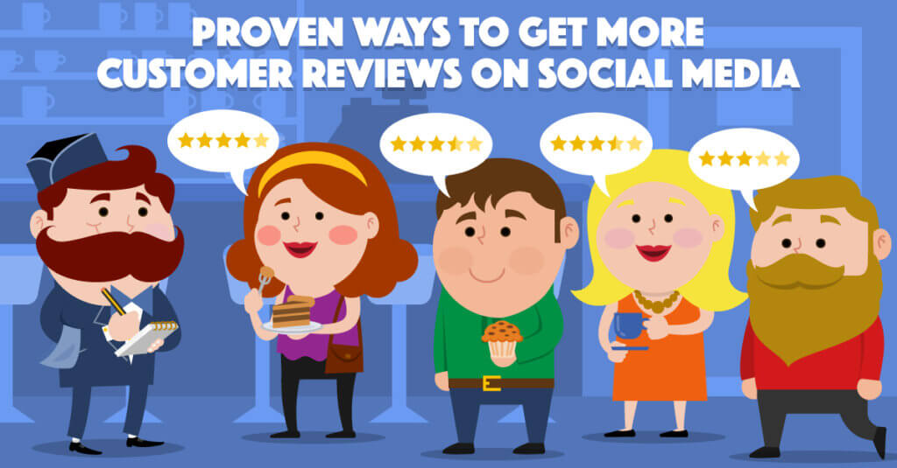
4. Users with most Friends

Slide 10
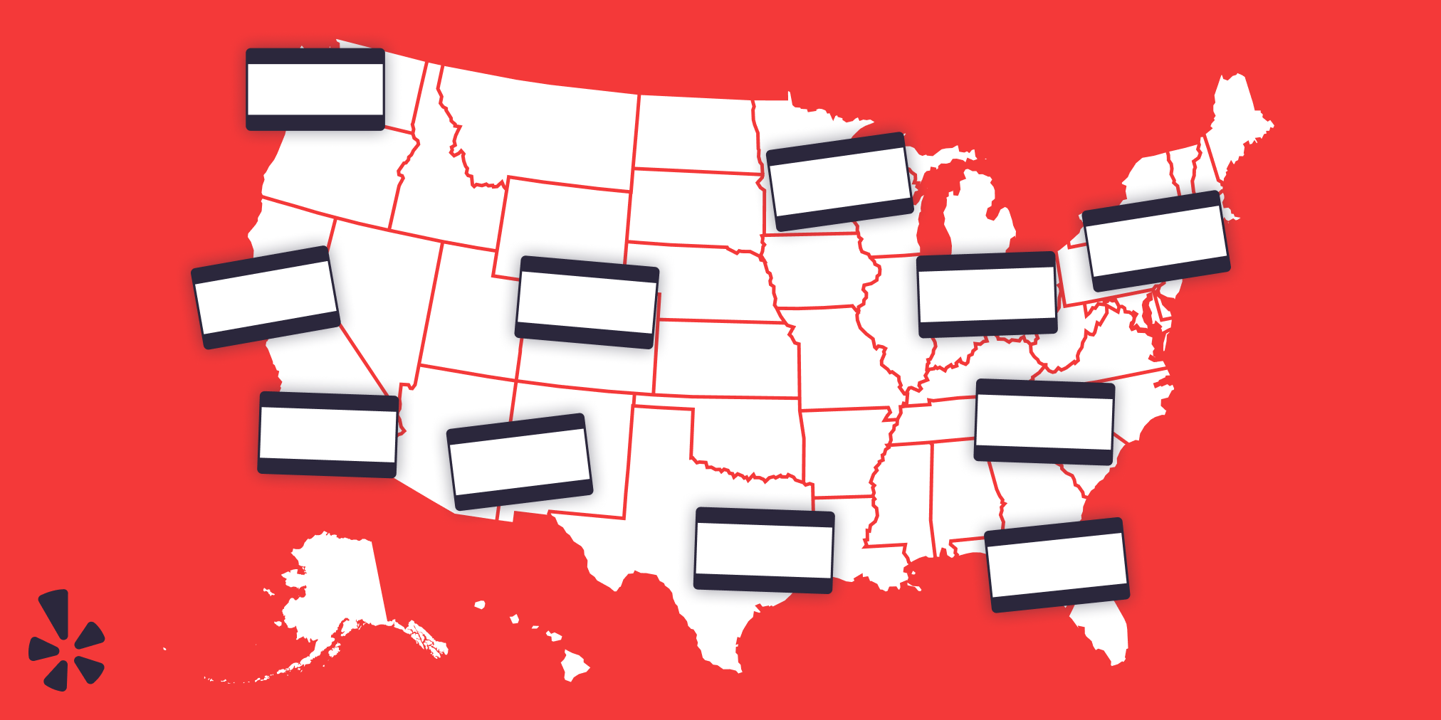
5. US States with Highest Businesses

Slide 11
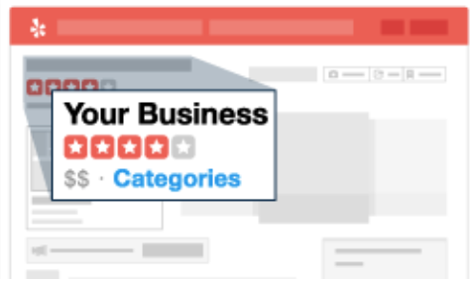
6. Top Ten Business Categories

Slide 12
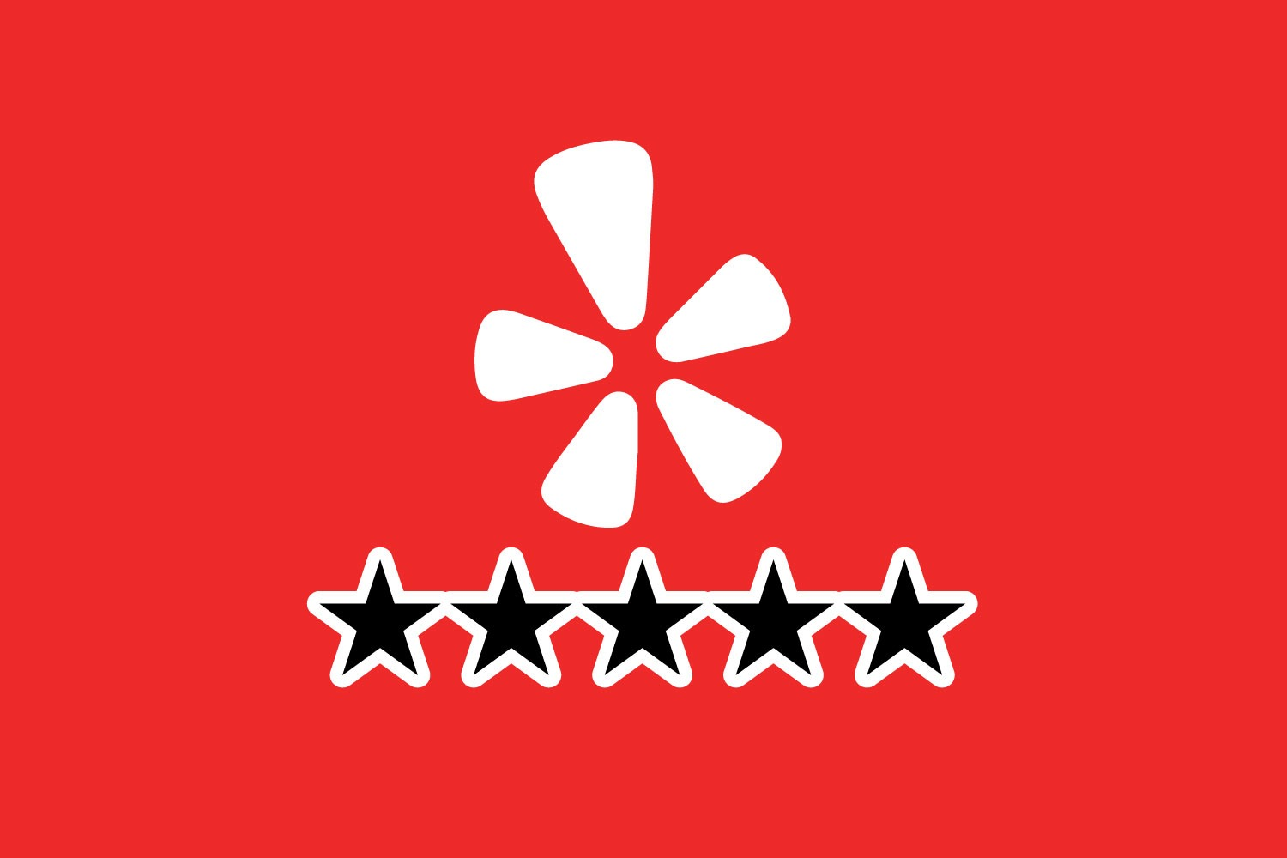
7. Average Rating of Top Business Categories

Slide 14
8. Most Funny and the least Funny Reviews

Slide 15
Examples of Funniest Restaurant Reviews
1. Menu reads better than performance of food. Having said that I got the short rib grilled cheese. Short rib was well seasoned and crispy. The cheese was non existent on the grilled cheese and onion condiment suits the short rib. The sour dough bread was beyond the moon excellent. The Farro salad also excellent. My daughter got the burger and description didn't match burger. Ordered burger medium rare and it was well done and dry. My husband got the fried chicken sandwich and it was ok. All in all the atmosphere really cute. Staff friendly. Perhaps today kitchen was having a moment. Oh wine order was wrong and salad came out from kitchen after entrees.
2. When walking down the French Quarter, this was about 1.9 miles, and we actually considered walking. Now before you consider wal - wait, don’t.
Your best bet to get to this heavenly, and yes, I mean HEAVENLY place (these donuts have officially provided me with an out of body experience) would be to drive your car and park on the sidewalk. Now with that being said, there's plenty of seats inside and outside of the place! Upon approaching the register, the woman working the counter gave us recommendations as I was looking into the gates of heaven. About eight donuts that are laid out inside of a small counter, with the workers constantly firing out more.
Exciting to say the least, I could feel the donuts calling me, "Jimmy, we're HERE! What you've been waiting so long for!" They were right, this place was always on the corner of my mind while walking through New Orleans. My first time coming here, I absolutely had to get four of them. Now enough of me talking, let's get into the donuts themselves: …………….
3. . If there's one important thing my mom taught me it's that there's always room for ice cream! One of the most iconic things about Mike's is definitely the location, in beautiful downtown Nashville. With country music blaring and tourists walking around, it kind of almost feels like home! Once I walked into Mike's the place was packed, and the weather, chilly as ever! Seeing as I was only spending a few days here, I had to go big, triple scoop for $5.50!
Here's the flavors I got: ………………………….

Slide 16
4. The best food-related thing that happened to me in 2019 was that when I tried to book dinner at Philadelphia's award-winning Zahav Restaurant, the place was unable to accommodate my request.
My dining companion, a local Philadelphian, suggested that we try Suraya, a Lebanese restaurant well-regarded by Philly's food press. Though I was skeptical of Suraya's newness and trendy popularity, I am a sucker for good Lebanese cooking, so I booked a reservation.
As a result, I enjoyed the best meal I've eaten in years. Thanks, Zahav.
[n.b. I'm about to sound ensorceled by Suraya's charms, so to maintain some credibility, here's my single complaint: Suraya's cardamom-scented kouign-amann was good, but not as good as one I had earlier that day at ICI Macarons & Cafe. That's it. That's all I've got.] ……………………………….
5. These D-O-N-U-T-S...OMG... All I can say is good thing I don't live by this place or I'd be in big trouble! This place was voted one of the TOP 10 donuts shops in America and I definitely know why!
Recently I made a trip to New Orleans for Mardi Gras and District Donuts was on my radar all the way from Los Angeles! Um yeah... I can sniff out good donuts from hundreds of miles away! ………………………………………

Slide 17
Examples of Least Funny Restaurant Reviews
1. New menu is amazing! Chef owner Zack has outdone himself by combining advanced culinary skills with surprising, unpretentious tastes and one of a kind dishes. You can still get your spicy fix, the best Dr Pepper ribs, bean hummus, burger, catch of the day, pot of pudding or deviled egg, but he's added a queso chock full of seafood, inspiring salads, a line of amazing sandwiches, tacos, unbelievable cheesecake and several other things I'm going back for. ………………..
2. Don't bother if you're in from out of town because they won't deliver to hotels. It's 2018 and this backward joint won't deliver to hotels. SMH!......................
3. Sorry but i really did not like this place. Passed up the hard benches for chairs, which were excruciatingly uncomfortable as well. Felt like tring the Purple Martin cocktail, grape soda and rum. It was undrinkable. Husband got a normal cocktail and liked it.Got a specialty salad, and it was ok, bot rather bitter greens. My meal went downhill from there. I ordered the chicken dish, and the chicken breast was dry, dry, dry. I ate half and took the rest home. My dog greatly enjoyed it………………………

Slide 18
4. Came here on Friday, June 3 with my parents for their anniversary. The day before I came to get a gift card for them for the meal, and those at the host desk were very nice and accommodating.
We came in and were sat immediately in one of the most comfortable booths I've been sat in. We were facing the center of the restaurant. The décor in this place is amazing. From the high ceilings to the dogs dining on the walls. It was fun to look around and see all the details.
We had to wait about 5 minutes or so before anyone even noticed us at the table. Small detail for a dinner that ended up being great. Dad got a long island iced tea, a little pricy at $13 but expected in the city at a nice place like this.
My dad and I both got the wedge. He got it how they make it, with I think Thousand Island dressing on it (and radishes, bacon, and blue cheese crumbles). I got it with blue cheese dressing on the side and no radishes. We both thought it was good, and I swear this was the best blue cheese dressing I've ever had. It had such a great taste, and it wasn't chunky. It was creamy but not too thick.
As a meal, dad got the Delmonico, as the waiter suggested because it was one of their most popular steaks apparently. He said it was absolutely wonderful, melt-in-your-mouth. He also ordered the mashed potatoes which were also some of the best I've ever had. They were so creamy and smooth, but you could tell they were NOT healthy haha!...............................................................
5. Went here for lunch today for the first time. I wasn't very impressed. We started with an antipasti plate appetizer, which was the most disappointing part of the lunch. For $16 it was very, very sparse and unimpressive. The soup and express lunch entree (cannelloni) were served hot and were rather tasty, but the portions were small and I was overcharged. It was supposed to cost $7.95 and you can add a side (the soup) AND drink for $2.00. Well the ticket charged us each $2.00 for the side and an additional $2.50 for each drink. I didn't say anything about it at the time and just paid the extra $5.00 but I definitely noticed. Our waiter brought the bread late and acted like he was doing something special or out of the ordinary in bringing us the oil and pepper to make a dip for our bread. The tables didn't have anything on them, not even salt & pepper shakers or sugar, etc.

Slide 19

Analyzation of Funny and Unfunny Reviews
While analyzing the data of reviews table, I found that approximately 80% of reviews are unfunny which is determined by number of users marking the review as funny is zero. When we look for top 5 funniest reviews it gives the same reviews but every time, we look for top unfunny reviews, it changes with every query run because of large number of unfunny reviews.

Slide 20

9. Tips Compliment Analysis

Slide 21
On Comparison of average length of 100 most complimented and least complimented tips, we found that the average length of 100 most complimented tips is higher than average length of 100 least complimented tips. However, the condition that the compliments on tips depends on length of tip does not seems true, as we have found several rows of review text with less length and higher compliments and vice-versa.

Slide 22
10. Data to Analyze Restaurant Reviews

Slide 23
As per the analysis of data, the number of days and hours open per week does not have a meaningful impact on the restaurant reviews.

Slide 24

Additional Questions on Yelp Data

Slide 25
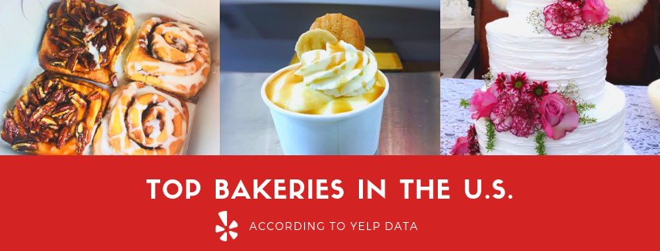
1. Top five Bakeries details with the highest average reviews in California

Slide 26

2. Details of the Businesses which has the most 5-star ratings for the year 2022

Slide 27
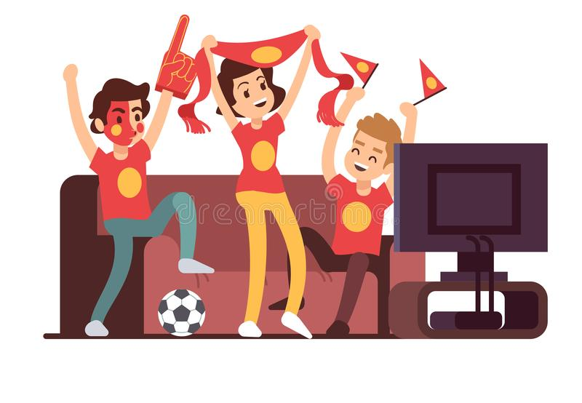
3. Top 5 users who have more fans than friends

Slide 28
4. Top 5 Restaurants details and their average reviews in Pennsylvania which are open all 7 days in a week and has the most number of reviews

Slide 29
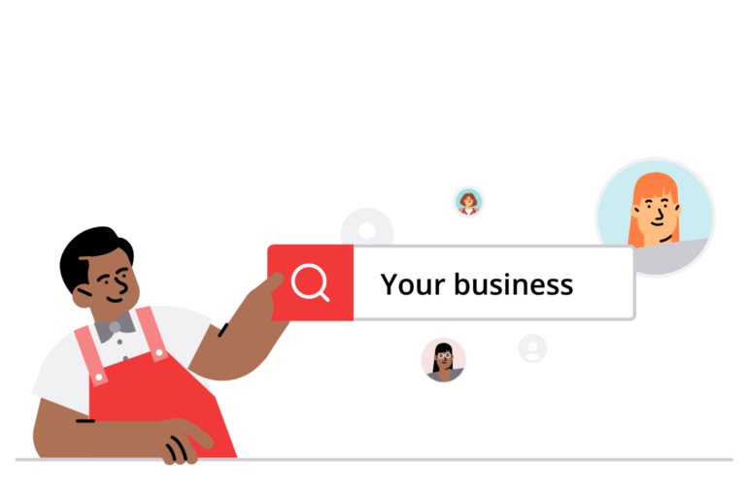
5. 15 Business Categories which has least Number of Reviews

Slide 30

6. Total Number of Restaurants which allows take - out 45381 Restaurants

Slide 31
7. Top ten users who has given maximum number of reviews

Slide 32

8. Total number of users who has not reviewed yet on yelp 54 Users

Slide 33

9. Top 10 business attributes which are most often used

Slide 34
10. List of the years with the highest number of tip left by the user

Slide 35

Personal Presentation

Slide 36

1. Challenge and its Solution
Challenge
My biggest challenge while working on this project was to solve the complex queries like 3, 8 & 10. These are the questions where I got stuck for a long time. Sometimes, I was knowing the next logical step but was not aware of the SQL syntax to execute the queries. It reminded me days of my competitive exam preparations when I use to solve the quantitative and logical questions in the same manner sitting for long hours.

Slide 37
Solution
The stackoverflow.com website has helped me a lot in overcoming these challenges. I started with the smallest logical part and iteratively build the solution for the query.
Definitely, it was a EUREKA moment for me, when I completed all my queries.

Slide 38

2. Easiest Part of the Project
In the whole project, creating and loading the database tables was the easiest task for me. I was creating the database with the free mind and may be that could be the reason which made the whole task easy.
Apart from that, I enjoyed making the presentation, especially when I got some cool and interactive images to use for the presentation.

Slide 39
3. Surprising Element about Data
The most surprising thing about yelp data was its list of business categories. It includes a total of 1311 categories from a diverse range of business.
While going through the review and user tables, I found that there are some data in review table where reviews given by the user are prior to the date when they joined the yelp.

Slide 40

4. Yelp’s Real Data
Based on the sample dataset provided, it looks like the real yelp database will be huge in size and it should be properly index so that the query can perform efficiently.
There are lot of analysis which could be done for different categories of businesses based on their reviews rating and comments.
I guess, yelp uses this huge amount of data to find customer trends and tries to provides local and unbiased insights to every category of business.

Slide 41

5. Recommendation to Yelp
Yelp should have more concrete process in place for data hygiene and data quality checks.
Yelp should enforce to populate some of the important data fields to provide a clear picture of their dataset. For example, for some of the businesses, street address was null.
Yelp should facilitate the user to use the predefined tags for the comments for a better understanding of their reviews. For example, using tags such as clean, tasty, hygienic etc.

Slide 42

Thank you.

